Slide 1
Overview IGT Solutions Risk Assurance and QE Capabilities

Slide 2
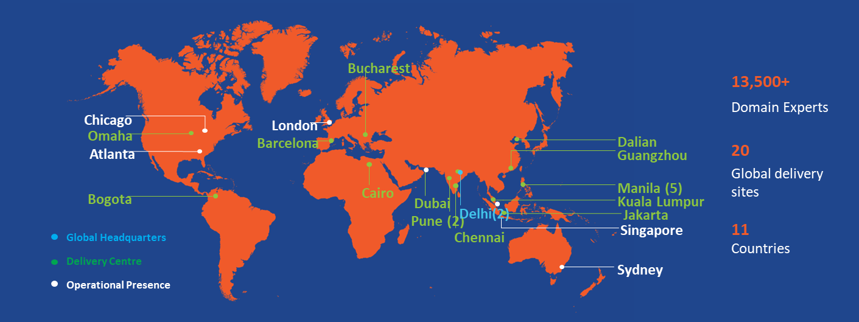





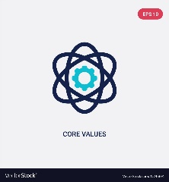


Who We Are
Customer-Centricity at the Core
Global Delivery
100% owned by APOLLO Group, a leading global alternative investment manager with approximately $280Bn entity.
Global Delivery
Diverse IT and BPM Solutions including Digital Engagement, Enablement and Enlightenment.
IGT’s technology-agnostic Xcelerate framework for delivering transformative solutions
20+ years
Integrated
75+
of industry experience
IT and BPM Solutions
Global Customers
Formal Accreditations
20+
Core Values
20
Digital Solutions & Frameworks
Integrity, Customer Orientation, Future-Mindedness
Global Delivery Centers

Slide 3















































Proud partner for leading global organizations…
… over 2 decades track record of delivering complex real-time high quality solutions
Aviation
Technology & Distribution
Internet Companies
Leisure & Hospitality

Slide 4
Risk Assurance and Quality Engineering Capabilities

Slide 5

QE and Testing as Risk Management Tool
… Risk Based Testing
Risk Profiling
Identifying Risk
Categorization
Probability
Frequency
Occurrences
Impact Analysis
Risk Weightage
Impact Score
Risk Based Test Strategy
Risk Mitigation by Testing
Top Risks Identified
Performance degradation
Performance Testing
Bad UX
Usability Testing
Key Business Benefits
Impact on existing workflows
Regression Testing
Delighted customers
Regulatory Compliance
Improved decision support system
Enhanced change control
Compliance issues
Compliance/ Conformation Testing

Slide 6
IGT QE Offerings and Pre-Built Frameworks
QE Consulting Services
QA Transformation
Intelligent Test Automation
Digital Assurance
Independent Product Testing
… customized services as per customer needs
Frameworks
Lean Testing
Risk Based Testing
Agile Testing
DevOps Testing
Shift Left

Slide 7














We can be your Quality Engineering & Testing partner….
Internet &
Technology
Energy
e-Commerce & Retail
Hospitality
Gov. Statutory
Logistics
Airlines & Airports
Maritime
Key Pillars
Enablers
Life Cycle Testing
Specialized Testing
Advisory, Test Mgmt.
end to end test management with experienced, expert human insight leveraging technology
Functional
Regression
Integration
Acceptance
Performance
Globalization/ Localization
Operational Readiness
CI / CD Testing
API Testing
Security Testing
Penetration Testing
Data Migration
Compliance Testing
DW / BI Testing
Certification Testing
Roadmap
Assessment
Testing CoE
DevOps
Agile Testing
Test Process Mgmt.
Test Program Mgmt.
Lifecycle Transform
flexible engagement & pricing models scalable global delivery model
across lifecycles including Lean, DevOps, Agile Scrum, Scaled Agile, Kanban, Water-fall, V-Model
innovation & device labs.
global partnerships
Quality Engineering services leveraging industry leading best practices CMMi, DevOps, DevSecOps, TestOps, Lean principles, TMMi & Agile
KPI & Metrics driven services
re-usable frameworks / artefacts
Intelligent Quality Leveraging AI / ML & NLP
Differentiators
Stats
~85+%
reduction in defect escape rate
6000+
person years of international enterprise level project experience
~15 to 25% reduction in overall cost
350+
Software QA Engineers
30+%
faster integrated release
45+%
reduction in Test cycle time

Slide 8

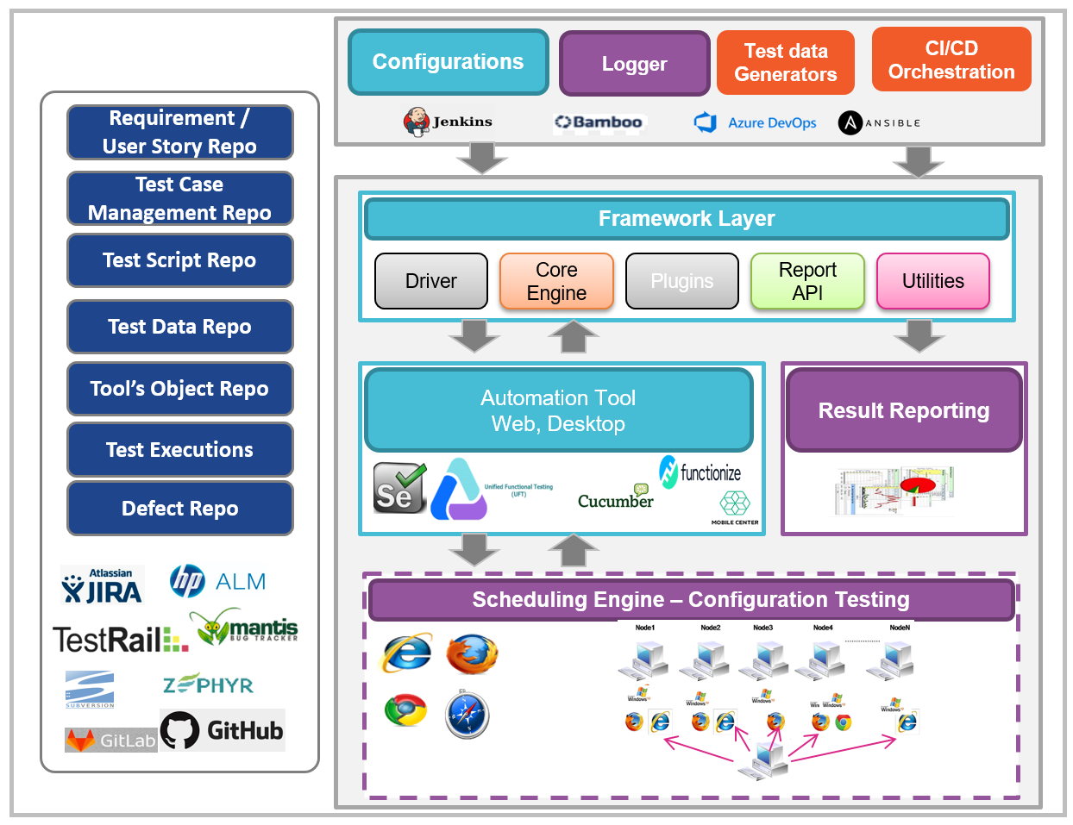
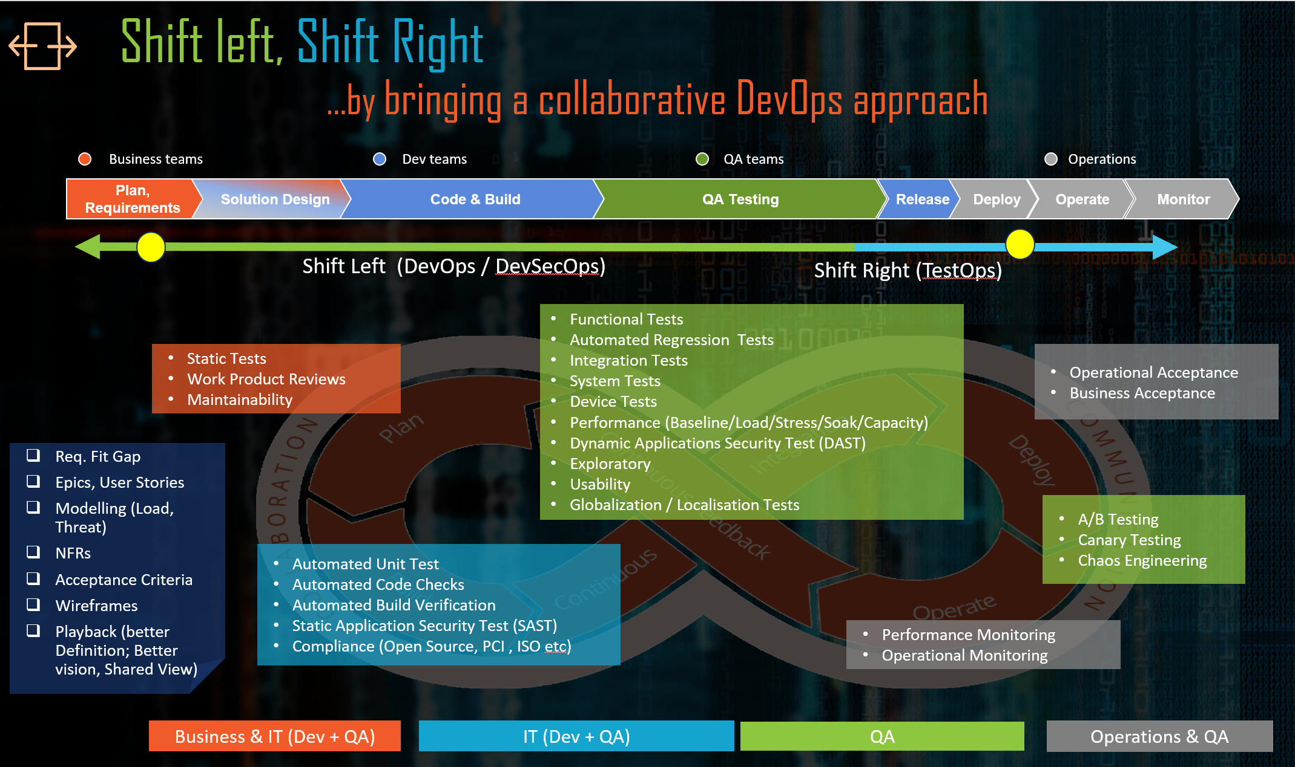
Transform from verification & validation…. …towards Quality Engineering
Test Early, Fail Fast…
DevOps based operating model where Business, Dev, QA & Operations collaborate to ensure First Time Right
Deploy, Test & Release on Demand
Leveraging automation tools across the lifecycle, including Advanced Automation to establish Continuous Testing & Release pipelines
TestOps
Understanding the actual operating environment & the challenges to have a continuous feedback to the engineering organization
Best-practices including Lean
Leveraging industry best practices DevOps, DevSecOps, Lean principles & TMMi
© IGT Solutions Pvt. Ltd. | Confidential: Not for Distribution | www.igtsolutions.com
“Technology and tool agnostic framework with applied methodologies & industry best practices to bring the focus on shift-left, automation and collaboration”
Compliance & Security
Leveraging DevSecOps best practices to ensure end-to-end focus
Speed
Accuracy of Testing
ROI
Quality Products Live
6

Slide 9




From Automation Scripts to Advanced Automation
… the power of human insight leveraging technology advances in AI / ML
Create Tests Case in plain English
Translated automatically using Natural Language processing & AI algorithms
Go to www.amazon.com
Click on button Search
4X
faster to market
80%
Reduced cost
10X
productivity increase
Model using ML+AI Algorithms
Model generated using technologies including Computer Vision, Machine Learning & AI algorithms
Execute parallel tests at scale
Detailed Insights for analysis
perform Intelligent Validation
Scalable runtime system in cloud
Cross-Browser
Integrations
Load & Stress Testing
Performance Analytics
Test Warnings
Root cause analysis
focus on business function of target application to be tested rather than traditional automation framework tooling technology focus
integrate with DevOps pipelines
Minimize Test Maintenance using AI+ML ,Computer Vision
Self Heal using Application Meta-Modeling, Statistical Models Element Selectors are Fingerprinted
Visual Template Recognition - What if the resolution changed? an object moved? Text changed
Update multiple test cases with a single click for failure correction
Tests are re-run in minutes

Slide 10
Cloud Testing Capabilities

Slide 11







Our Cloud Testing Capability
Cloud APIs
Micro Services
Testing of pre-built APIs, Integration, Gateways, Database APIs, Networking APIs
Testing of Integrations, Contract, Services, scalability, Containers, Performance
CLOUD
TestOps
TESTING
Testing of DevOps, CI/ CD Pipeline, Automation, performance, security, integrations, functionality
AI/ML led Testing
IoT Over Cloud
Testing of seamless data access, sentimental analysis, model training, Accuracy analysis
Testing of IoT devices, platforms, Data protocols, Security, Network, Heterogeneous interphases
Performance
Availability
Security
Multi-Tenancy
Interoperability
Usability

Slide 12










Intelligent Cloud Testing Solutions
Assuring your cloud journey achieves stated objectives
CLOUD COMPUTING LANDSCAPE
Cloud Sub Domains
Cloud
Transformation
IaaS
PaaS
NaaS
SaaS
IGT Cloud Test Offerings
Cloud Transformation Assurance
IaaS Testing Services
PaaS Testing Services
NaaS Testing Services
SaaS Testing Services
Coverage
SLA
KPI
Security
Timeline
Performance
Security
Scalability
Storage
Networking
OS
Database
Web server
API
Web GUI
Networking
Firewalls
Security
On demand software
Availability
Performance
IGT Pre-built Levers
Cloud Testing Lab
Standard Use Cases
Zero lead time
Frameworks on Cloud
Client benefits
Better Risk Management
Insightful Analytics
Improved Performance
Better ROI
Faster deliveries

Slide 13











IGT Cloud Testing Lab
Pre-built Accelerators
TOOLS AND FRAMEWORKS
Test Data Generators, Processes, Re-usable artifacts, Assets, Plugins
MULTI BROWSERS
Chrome, Firefox, IE11, Safari,
Mobile Browsers
DASHBOARDS
Intelligent Reports, Customized Dashboard, Tracking KPIs and SLAs
AUTOMATION
CLOUD TESTING LAB
Automation of UI, Integration, Component, Services
DEVICES
Physical devices,
Emulators
IGT Cloud Testing Centre of Excellence
Innovations
Re-Usable
Artefacts
Processes
Thought
Leadership

Slide 14




Our Alliances and Partners
… staying ahead of the curve complementing strengths of IGT and our partners
Test Automation
Performance Engineering
Model Based Testing
Performance Engineering
Performance as code
Shift left – Load Testing
Automation Testing
AI/ML enable
Cloud based
Smart Analytics
Azure DevOps
Issue management
Test Management
Automation

Slide 15





We support multiple Engagement Models basis your business needs
Delivery Units and KPI’s for assured quality deliveries
Application Development
Quality Engineering
Maintenance & Operations
Delivery Units
Time & Material
Fixed Price
Scrum Teams based
Output based (Story Points, FP-IFPUG, FP-Mark 2
T-Shirt Based SPE
KPI’s
Throughput | Stories / Sprint Stories / Month Tickets / Months
Technical Debt | # Blockers # Critical Complexity Code Duplication % Unit test Coverage % Functional test coverage
Defects | % Unit test pass % Func test pass % NFR pass # Severity Defects Ageing
Open Source | No non compliant Open Source usage
Rework | % of rework in terms of size
Schedule | Schedule variance
Delivery Units
Managed Services
Unit Based (Test Case, Scripts etc.)
Capacity
Value delivery
Risk Shared
KPI’s
Automation | % Automation Coverage
Defects | % Defect released to UAT % Defect release to production % Defect prevented
Schedule | Schedule variance
Quality | % Test environment availability % Test data availability
Delivery Units
Time & Material
Capacity
Volume with range
KPI’s
Response SLA | % responded within stipulated SLA
Resolution SLA | % resolved within stipulated SLA
Problem Management | % RCA completed within stipulated time
Quality | % tickets reopened # of defect free releases
Backlog | # days of aging
across lifecycles including Water-fall, V-Model, Agile Scrum, Scaled Agile, DevOps, Kanban
leveraging industry leading best practices including Agile, DevOps, DevSecOps, TestOps, Lean, CMMi, TMMi, ITSM
flexible engagement & pricing models scalable global delivery model

Slide 16
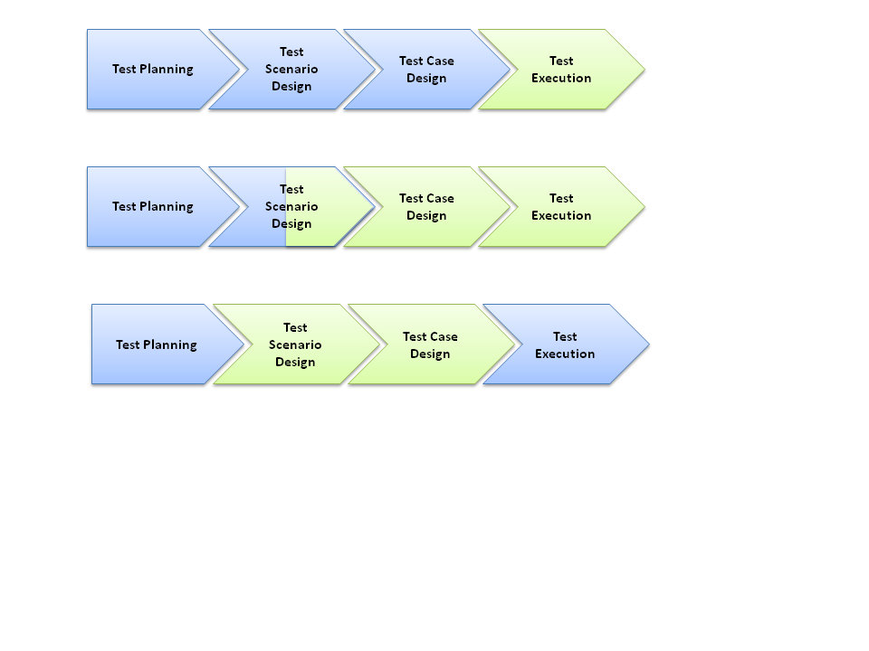

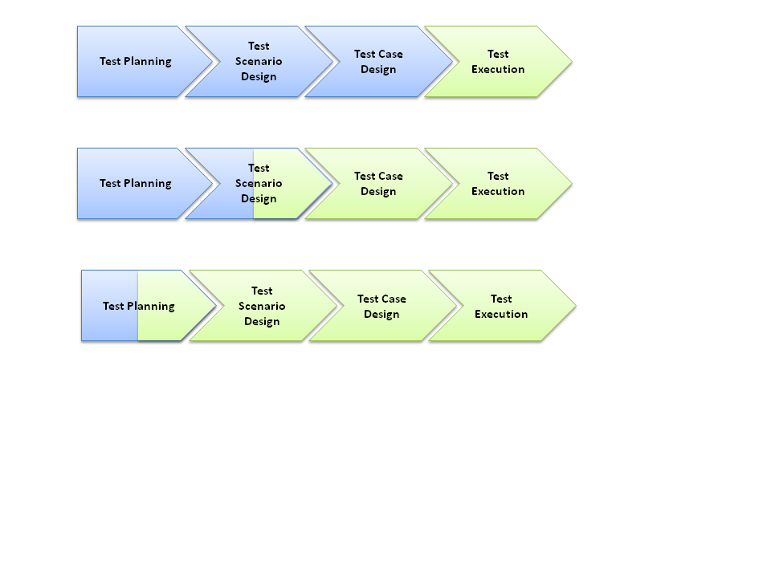
IGT Quality Engineering - Delivery & Pricing Models Bouquet
Delivery Models
Pricing Models
Design Factory
Time & Material
Crowd Sourced Pricing
Execution Factory
Fixed Bid
Fixed Capacity
Partial Project Ownership
Commoditized Pricing
IGT’s unique Pricing Models coupled with stringent Project Governance & complete Quality Assurance ensures that our clients get the Best Return on Investments
Managed Services
Involvement
IGT
Client
Deployment Models
Deployment Models
Onsite
Offshore
Near shore
Hybrid
Remote

Slide 17



Ensuring Commitment with a Strong Governance model
…building foundations for a mutually beneficial & growing long term relationship
Executive Management / Leadership
Senior Management
Account Management
Executive Management / Leadership
Customer Program Sponsor(S)
Customer Senior Management
Quarterly Portfolio review
Strategic Review of Engagement
Vision
Strategic
Review
Fortnightly / Monthly review
Strategic objectives
Long-term planning
Metrics Review
Continuous improvement update
Head - Digital Engineering
Delivery Head
Onshore Delivery Manager
Customer Delivery Executives
Customer Portfolio / Program Managers
Strategy
Executive
Review
Governance
Fortnightly review
Risks and Mitigation
Program planning
Staffing changes
Escalation management
Delivery Head
Program Manager
Program Manager(s)
Project Managers
Decision
Program Management
© IGT Solutions Pvt. Ltd. | Confidential: Not for Distribution | www.igtsolutions.com
Weekly review
Weekly planning
Risks and Mitigation
Change management
Project Manager(s)
Team Leads
Teams
Project Manager(s)
SME’s
Customer Team
SPOC
Execution
Project Management
CUSTOMER

Slide 18
Key Engagements

Slide 19


Serving Customers Across the Globe
Key Engagements
Areas: Airline PSS System, Reservations, Cargo, Loyalty, Social Media, Infrastructure, Immigration
Engagements: Product Validation services, Automation testing, Functional testing, Performance testing, Dashboard reporting, KPI and SLA measurement and reporting,
Areas: Reservations, Ticketing, Loyalty, Baggage, Passenger Security, Inventory, Interline through Check-in, Flight Ops, Payments, Upsell
Engagements: Mainframe validation, Assurance on reservations system, Functional and Regression testing
Areas: Cruise Booking Engine, CMS, Payments, Flight Seat Booker, Time Zone Sync, Crew Flight Bookings, On-board Ancillaries such as Spa, Dining, Gifts
Engagements: Product Enhancements validation, System Integrations, GDPR Compliance validation, ETL testing, Data Science, BI & Analytics assurance
Since: 2013
Since: 2012
Since: 2011
Areas: Airport Systems, Immigration & Border Control, electronic Visa Passenger Handling, Hotel Statutory Compliances, Airline Systems
Engagements: Product Engineering, Security testing, DevOps alignment of quality engineering, System integration, Performance testing, Lean Testing, UAT
Areas: Baggage, Queues, Reservations, Cargo, Crew and Pilot Pay, BSP Refunds, Social Media, Employee and Corporate Travel
Engagements: Reservation system workflow validation, System Integration, Performance testing,
Areas: Sales, Inventory, Promotions, Margins, Pricing, Targets & Prediction on Stocks, Infrastructure and User Management
Engagements: Validation of Business Intelligence Reporting Solution containing Interactive Dashboard, PDF/Excel Export Documents
Since: 2010
Since: 2010
Since: 2014
Areas: B2C and B2B Hotel Reservations, Payments, Property Management System (PMS) and Online Travel Agencies (OTAs)
Engagements: Assurance on central reservation system, Product testing, Functional and regression testing, Integration testing
Areas: Property Management System (PMS), Hotel Reservations, Lounge Bookings and Ancillaries, Meet and Greet, CMS, Payments, Upsell, Cross-Sell, Business Rule Engine
Engagements: Mobility validation, UI/UX assurance, Independent Testing, Assurance on Cloud Services
Areas: B2B Contract Loading, GDS Distribution, Hotel, Rate Creation, Event Creation, PCC Mapping
Engagements: Business Validation services to all the end to end functionalities, performance modelling and load tuning testing
Since: 2014
Since: 2018
Since: 2019

Slide 20
Thank You

